Slide 1
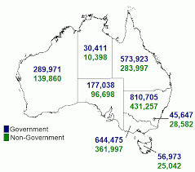
Project Title: Schools Australia
Team members
Hesh Kuruppuge
Jasjeet Kaur
Yao Ding
Aravind Sama
DATA SOURCE: ABS Schools Australia
A map of Australia showing student enrolment counts by state and territory and affiliation for 2020

Slide 2

Research Purpose
Analyzing the most recent (2020) ABS enrolment statistics allows us to,
Identify student's historical and current enrolment trends
Project future enrolments (until 2030)
across Government and non government sectors at National and state/territory level.
Research Questions
What is the number and percentage of student enrolment by state in last 5 years (2016-2020)?
How does indigenous and non indigenous enrolment differs in each state/territory in last 5 years (2016-2020)
What is the number and percentage of student enrolment by affiliation in last 5 years (2016-2020) nationally and by state/territory?
What is the trend in student enrolments for last 15 years for each Australian state/territory? Is there a difference in student enrolments pre (2018) and post (2020) pandemic period? Forecast the student enrolments for 2030?
How does population relates to student enrolments in each state?

Slide 3
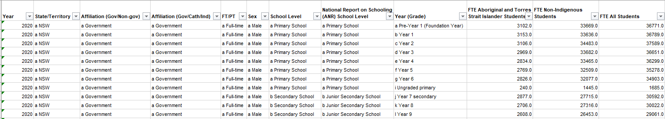
Data Source
Australian Bureau of Statistics, ABS Schools Australia Schools, 2020
Data on students, staff, schools, rates and ratios for government and non-government schools, for all Australian states and territories (60 kB)
https://www.abs.gov.au/statistics/people/education/schools/latest-release (Table 43a was used)
ABS National, state and territory Population
https://www.abs.gov.au/statistics/people/population/national-state-and-territory-population/latest-release
Table: 43a –14,000 R X 12 C

Slide 4

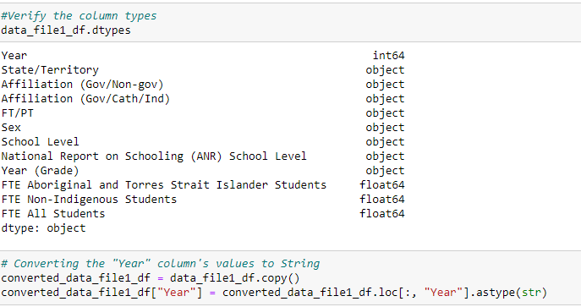
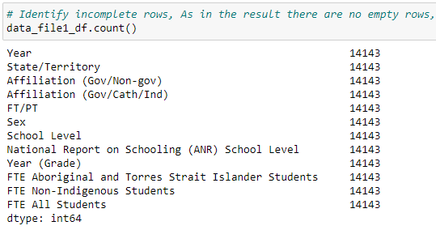
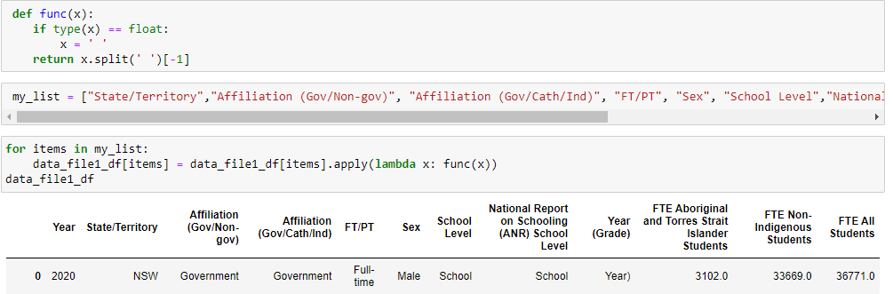
Data exploration and clean up
Jupyter notebook link
Read raw data from excel file
3. Checked the data types and converted year from integer to string
2. Screened for any empty rows
4. Removed prefixes in each column
Notes:
Thank you Aravind.
>As Aravind showed in previous slide, we used two data sets through out this research and ABS schooling data set is the one we were highly dealing and most of the coding and Visual representations are based on schooling data set. Therefore this slide and next two slides I will be taking you through the Schooling data set.
1) By the way these both data sets were in Excel format and the first point in this slide shows how we read the data set in Panda.
2.) After that we checked the data set for null values , as you can see there were no null values at all in this data set.
3) As a third point we checked the data types and converted Year into type String
4) The last cleansing step on this

Slide 5
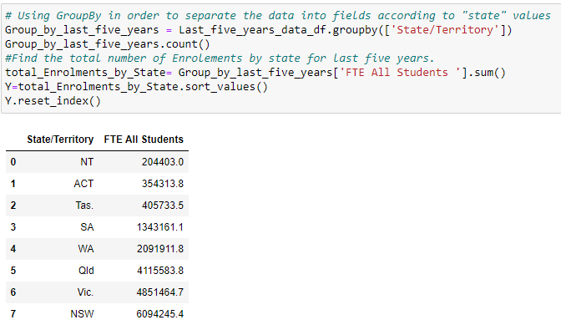
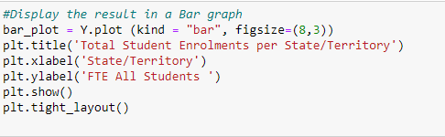
Data analysis process
Jupyter notebook link
Filtered data based on year to get last five years data (2016-2020)
2. Used Groupby function to split data based on multiple criteria’s based on the question.
3. Created a Bar Graph from grouped data

Slide 6
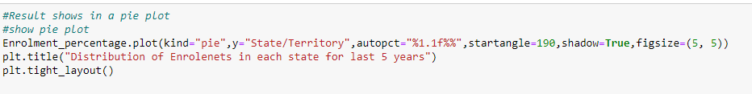


Continue…Data analysis process
4. Created a Pie Chart to calculate the percentage of student enrolment in grouped data
5. Created a scatter plot to look at the trend of student enrolment in each state
Done the linear regression to predict future
6. Merged population and the Enrolment data frames to see the core relation between two data sets.

Slide 7
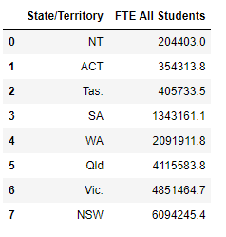
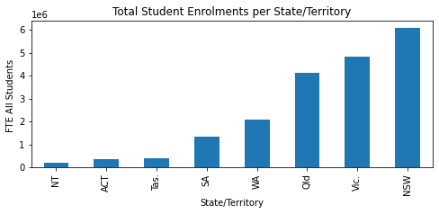
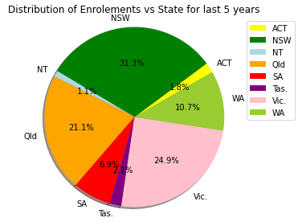
Numerical summary , visualisations and findings
1. What is the number and percentage of student enrolment by state/territory in last 5 years (2016-2020)?
Table 1
Figure 1a: Bar chart
Figure 1b: Pie chart
NSW and Victoria have the highest number of student enrolments in last five years
NT and ACT have the lowest number of student enrolments
Notes:
Thank you Hesh. So, the data cleansing and analysis helped us answer our 6 research questions.
Our first research question was to find the number and percentage of student enrolments by state/territory in last five years.
To answer this, we have presented a numerical summary of student enrolments in each state in Table 1 which was also plotted in a bar chart as shown in Figure 1a.
The percentage of student enrolments for each state was presented in a pie chart as shown in Figure 1b.
Our findings show that NSW and Victoria have the highest number of student enrolments while NT and ACT have the lowest in last five years.

Slide 8
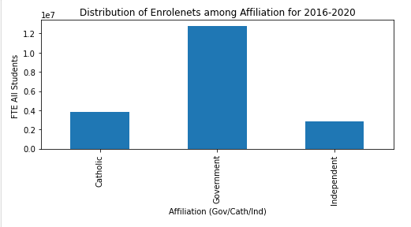
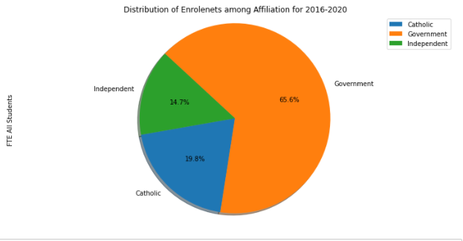
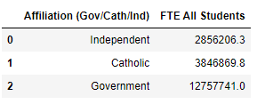
Numerical summary , visualisations and findings
2. What is the number and percentage of student enrolment by affiliation in last 5 years (2016-2020) nationally and by state/territory?
Table 2
Table 2
Figure 2a: Bar Chart
Figure 2b: Pie Chart
Nationally, government schools have higher student enrolments than non-government schools (catholic and independent)
Notes:
Our second research question was to find the number and percentage of student enrolments by affiliation in last 5 years (2016-2020) nationally and by state/territory?
To answer this, we have shown the numerical summary of student enrolments nationally based on school affiliation i.e. independent, catholic and government schools in the last five years in Table 2 which is also presented in a bar chart in Figure 2a and as a pie chart in Figure 2b. Our findings from these visualisations show that Nationally, government schools have higher student enrolments than non-government schools (catholic and independent).
Figure 2c shows a bar chart comparing the student enrolments in different states by affiliation. Our findings from Figure 2c shows that in all Australian states/territories, government schools have higher student enrolments than non-government schools

Slide 9
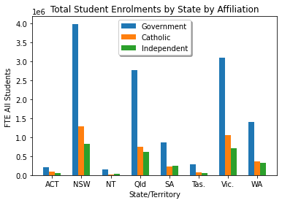
Continued…Numerical summary , visualisations and findings
Figure 2c: Bar Chart
NSW and Vic record the highest number of enrolments in each affiliation.

Slide 10
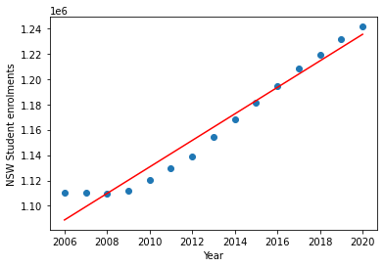
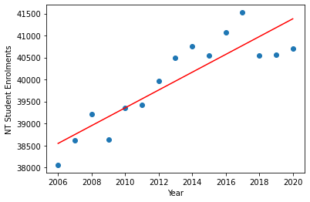
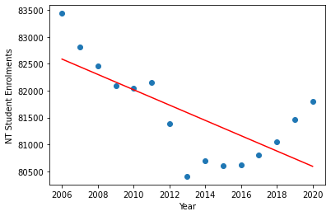
Numerical summary , visualisations and findings
3. What is the trend in student enrolments for last 15 years for each Australian state/territory?
Forecast student enrolments for 2030?
Is there a difference in student enrolments pre (2018) and post (2020) pandemic period in NSW, NT and Tas?
The r-squared is: 0.960784825711232
The r-squared is: 0.78517497932712
The r-squared is: 0.4904618341953918
NSW
NT
Tas
'y = 10453.16x + -19880190.75'
'y = 202.34x + -367341.94'
'y = -142.38x + 368205.47'
Figure 3a: Scatter plot
Figure 3b: Scatter plot
Figure 3c: Scatter plot
The student enrolments in 2030 for NSW will be 1339729.85.
The student enrolments in 2030 for NT will be 43402.46.
The student enrolments in 2030 for Tas will be 79168.99
Linear regression analysis for forecasting student enrolments
Student enrolments have continued to increase despite of the pandemic
Creating a write-up summarizing your major findings. This should include a heading for each “question” you asked of your data and a short description of your findings and any relevant plots.
Notes:
Our third research question was to observe the trend in student enrolments for last 15 years for each Australian state/territory? Understanding of this trend will lead us to predict student enrolments in 2030. The visualisation of the enrolment trends will also enable us to find out if there is a difference in student enrolments pre (2018) and post (2020) pandemic period.
To answer this, we made 3 scatter plots showing enrolment trends for NSW, NT and Tas as these 3 states had distinct trends while other states followed similar trend as NSW.
We did a linear regression analysis to create a line equation to forecast the student enrolments in 2030.
Our findings show that student enrolments in NSW and NT have increased linearly in last 15 years while in Tas the overall trend in student enrolments has declined over the years and is starting to go up since 2017.
We can also observe that the student enrolments continued to increase despite of pandemic.

Slide 11
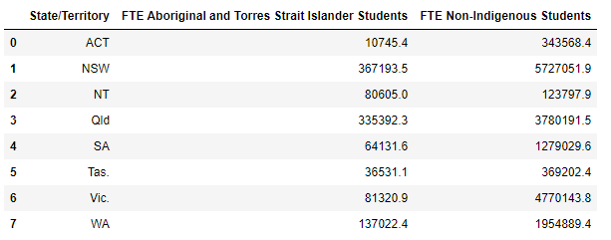
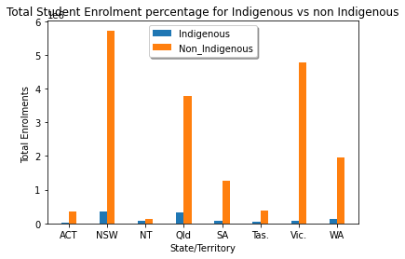
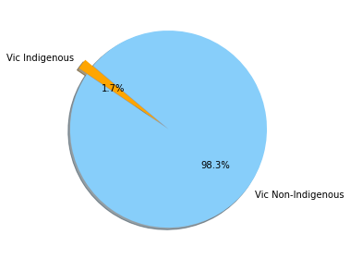
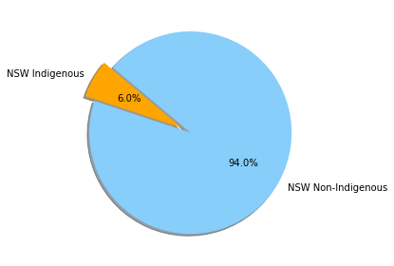
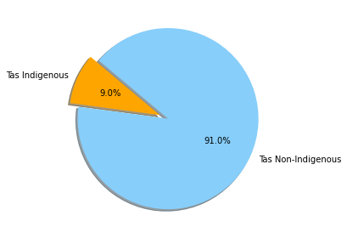
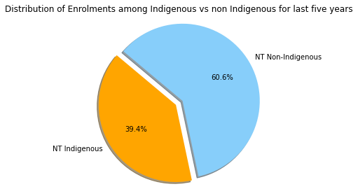
Numerical summary , visualisations and findings
4. How does indigenous and non indigenous enrolment differs in each state/territory in last 5 years (2016-2020)?
Table 4
Figure 4a: Bar Chart
Vic has the lowest proportion of indigenous enrolments and NT has the highest
Proportion of indigenous enrolments
Vic, ACT, SA (1-5%)
NSW, WA, Qld, Tas (5-10%)
NT (40%)
Figure 4b: Pie Chart

Slide 12
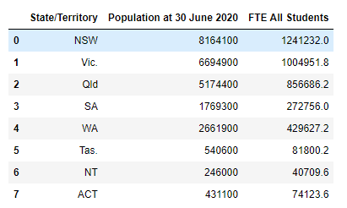
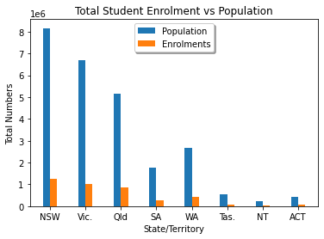
5. How does population relates to student enrolments in each state?
Numerical summary , visualisations and findings
Table 5
Figure 5a: Bar Chart
School Enrolments and the population distribution among states/territories take the same pattern.
NSW and VIC record the highest
NT and ACT record the lowest

Slide 13
The implications of your findings: What do your findings mean?
NSW and Victoria have the highest population, therefore the percentage of student enrolments in these states are the highest
Student enrolments in Tasmania showed a decline from 2006-2015 and is now catching up a positive trend since 2017
Forecasting to 2030 shows that NSW will have extra 100,000 student enrolments that year, therefore increased infrastructure will be required
Measures should be taken by governments of Victoria, ACT and SA to increase the enrolment of Indigenous students

Slide 14


Slide 15


